Slide 1

Secure Campus Area Network Design
Course: 19ECE311 – Computer Networks
Semester: S6 – BTech ECE

Slide 2

Team members
AISWARYA SANTHOSH : AM.EN.U4ECE22007
ANAND MAHADEVAN : AM.EN.U4ECE22008
DEVARSH MD : AM.EN.U4ECE22015
MUHAMMED BASIL K : AM.EN.U4ECE22025
NIVED G UNNI : AM.EN.U4ECE22031

Slide 3
INTRODUCTION
Organizations with multiple departments or branches require a centralized and secure communication network.
A Campus Area Network (CAN) serves this need by interconnecting various buildings/locations under a single enterprise.
The project focuses on designing such a CAN for an enterprise with two key locations: A (clients) and B (central server).
Key concern: ensuring network security, controlled access, and data integrity in inter-location communication.
BACK TO AGENDA PAGE

Slide 4
OBJECTIVE OF THE PROJECT
To design a secure and efficient Campus Area Network (CAN) for a two-location enterprise setup, ensuring seamless and controlled data flow.
To implement logical segmentation using subnetting and VLANs, which helps in isolating traffic and reducing broadcast domains.
To configure Access Control Lists (ACLs) on routers to restrict communication and enforce rules like:
Only specific client PCs can access the server.
Blocking ping or unauthorized access attempts.
To deploy firewall rules that monitor and manage incoming requests, allowing only traffic that meets strict security policies.
To ensure scalability, fault-tolerance, and security in real-world network scenarios using tools like Cisco Packet Tracer.
To simulate enterprise-grade network behavior and security practices for educational and real-world relevance.
BACK TO AGENDA PAGE

Slide 5
NETWORK DESIGN OVERVIEW
The CAN spans two physical locations:
Location A: Client devices in VLAN1/Subnet A
Location B: Central server in VLAN2/Subnet B
Key Features:
Router connects both subnets.
Managed switches control local traffic within each location.
Server in Location B is the sole data source with restricted access.
Visual: Include a simplified topology diagram showing all devices.
BACK TO AGENDA PAGE

Slide 6
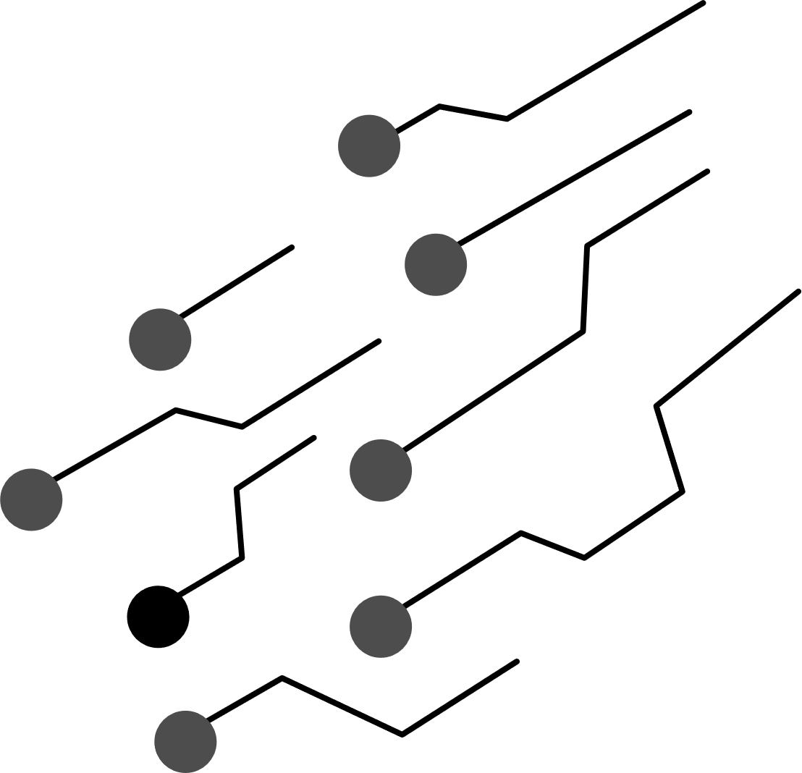
Subnetting & VLAN Configuration
Subnet A (192.168.1.0/24) → Assigned to VLAN1 → Users at Location A
Subnet B (192.168.2.0/24) → Assigned to VLAN2 → Server at Location B
Purpose:
Segment and isolate traffic for security and efficiency.
Reduce broadcast traffic and allow easier management.
Benefits:
Easier policy enforcement
Reduced attack surface
BACK TO AGENDA PAGE

Slide 7
ACL Configuration
Firewall Rules
ACL applied on the router interface that bridges the two subnets.
Access control logic:
Deny general communication from clients to server subnet.
Permit access from only selected PCs (PC0–PC5) to server’s web port.
Block ping requests to the server to reduce reconnaissance risks.
Outcome: Only authenticated and authorized devices can interact with critical resources.
Configured on the network firewall at Location B:
Allow: Web traffic from subnet A to the server (e.g., HTTP/HTTPS).
Deny: All other inbound connections to the server.
Justification:
Provides layered defense beyond ACLs.
Shields server from internal and external unauthorized access.
BACK TO AGENDA PAGE

Slide 8
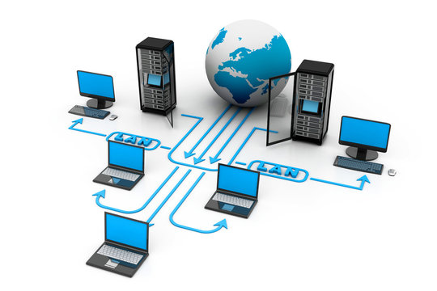
Software & Hardware Requirements
Software
- Network OS with VLAN & ACL support
- Firewall software
- IDPS software
- Remote access tools
- Network monitoring & management tools
Hardware
- High-performance routers
- Layer 3 managed switches
- Next-Gen Firewall (NGFW)
- Authentication server (e.g., RADIUS)
- Web/Application server
BACK TO AGENDA PAGE

Slide 9
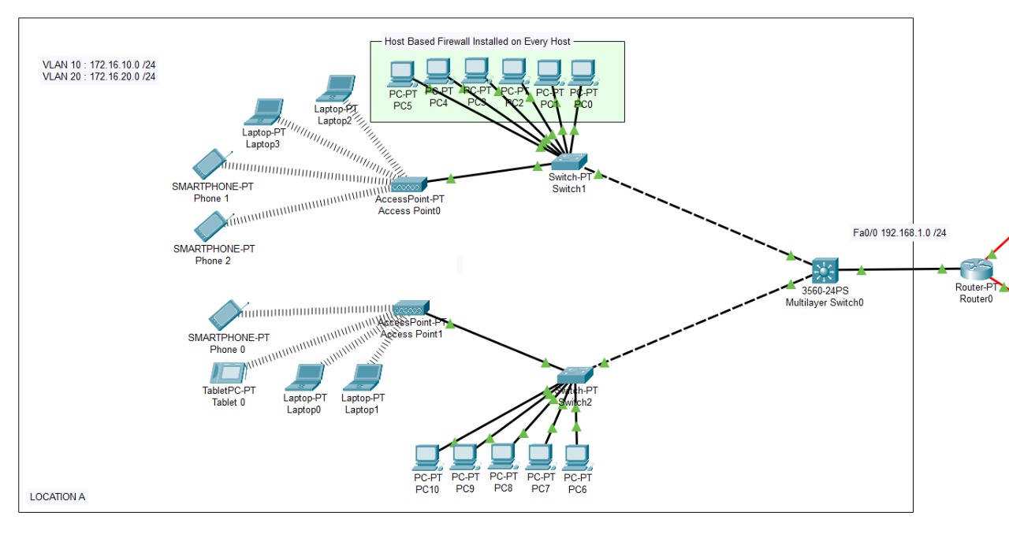
IMPLEMENTATION
Location-A

Slide 10
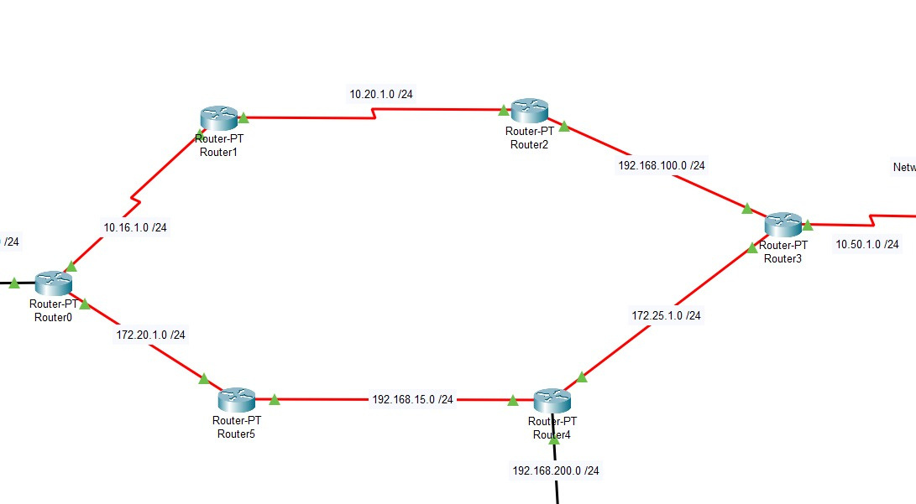
Location-B

Slide 11
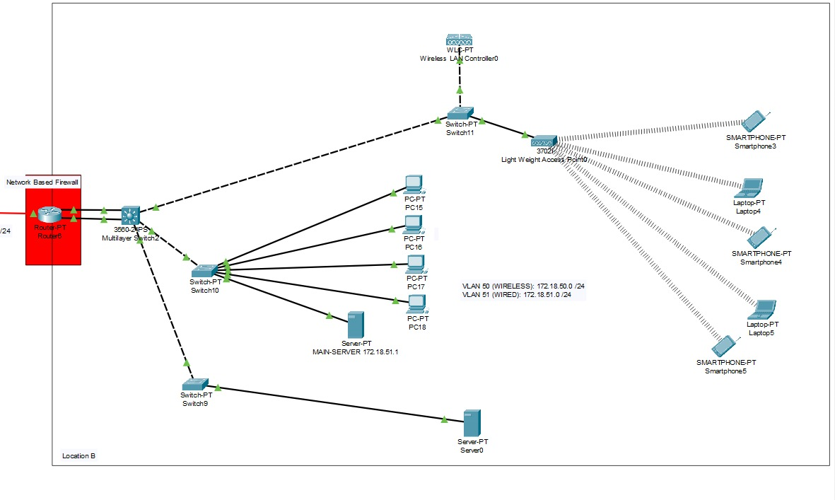
Location-C

Slide 12
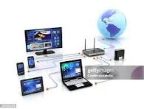
Results
Subnets and VLANs successfully segregated network domains.
ACLs prevented unauthorized access, while selected clients accessed the server.
Firewall policies enforced granular access control.
Achieved:
Reduced traffic collision
Increased security
Controlled resource sharing
Validated simulated behavior with expected outcomes.
Project Website:
Access the full project details at:
• https://devarshmd.github.io/CN-PROJECT/

Slide 13
Conclusion
Successfully designed a secure and structured CAN for a dual-location enterprise.
Applied best practices in network design: subnetting, segmentation, access control, and firewalling.
Enhanced understanding of real-world network threats and how to mitigate them.
The project reinforced the importance of layered security and planned architecture in enterprise networking.

Slide 14
Future Enhancements
Advanced Threat Detection:
Use ML/AI for anomaly detection in traffic patterns.
Zero Trust Network Model:
Authenticate every user/device before allowing any access, even within the network.
Software Defined Networking (SDN):
Centralize network control, automate responses to threats.
Cloud Integration:
Host parts of the infrastructure in the cloud with hybrid access models.

Slide 15

THANK YOU

